Slide 1

Shotmaniacs Group 1
Beau Jonkhout, Pavan Awadhpersad, Baris Yilmaz, Raphael Ritz, Alex Culda, Raluca Gavrila

Slide 2
Logistics
Planning
Design
Mock-up
Contents

Slide 3
Logistics.

Slide 4
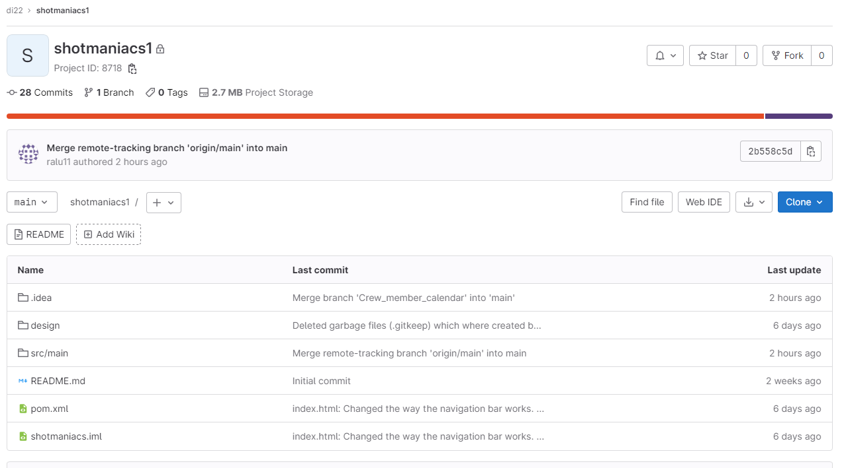
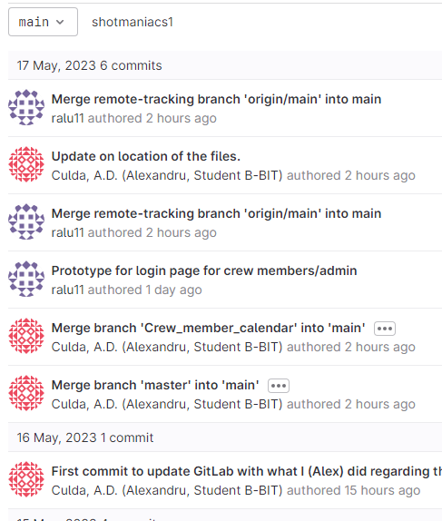
Gitlab

Slide 5
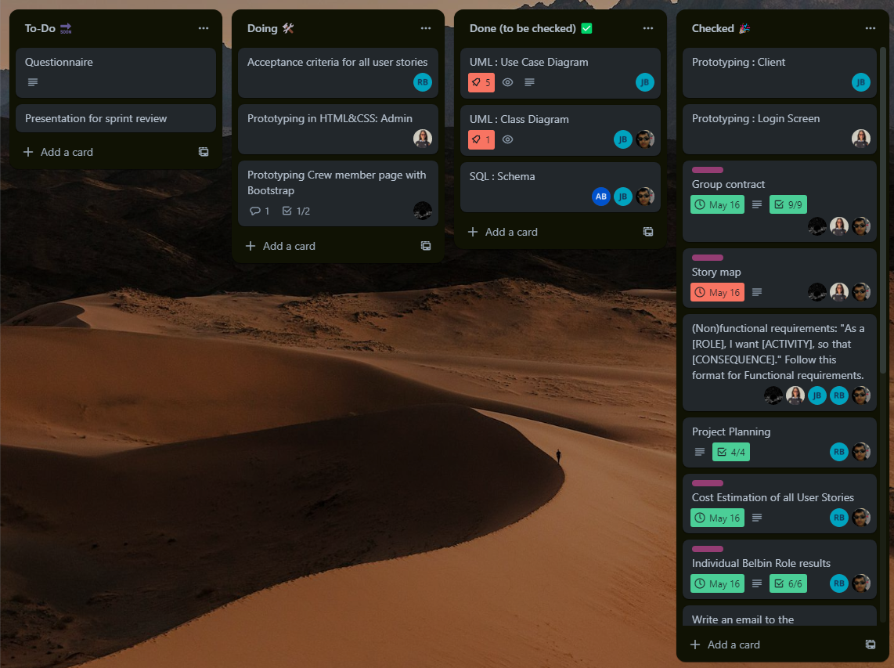
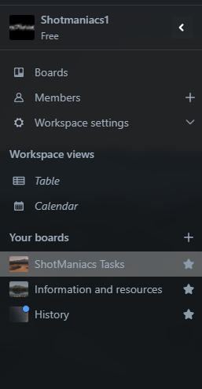
Trello

Slide 6
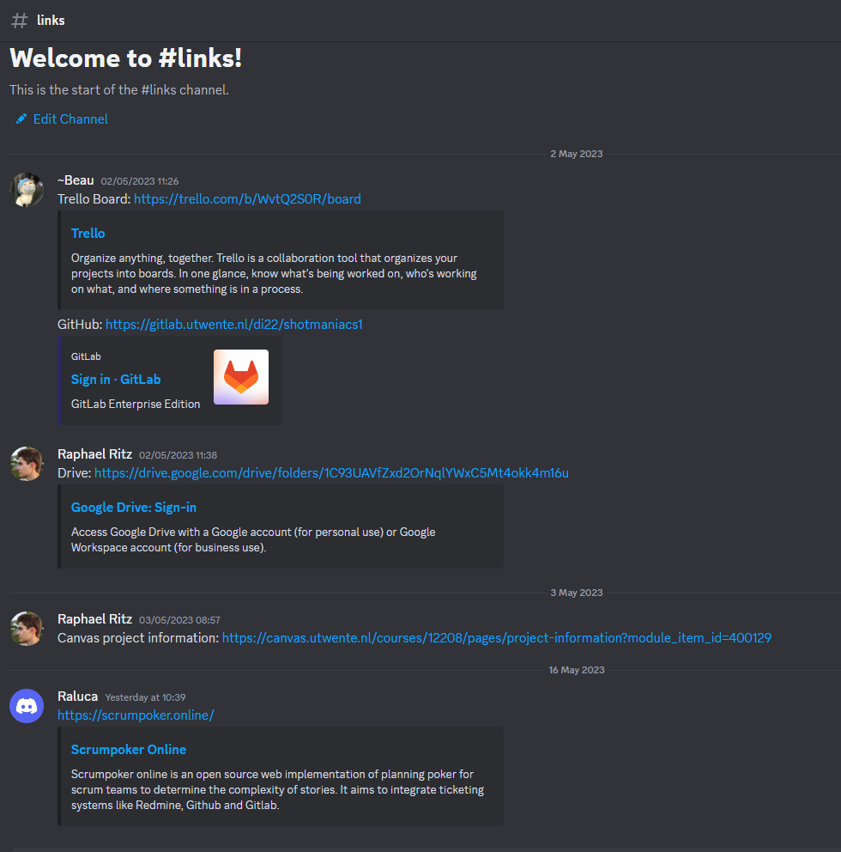
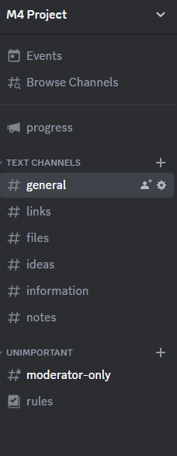
Discord

Slide 7
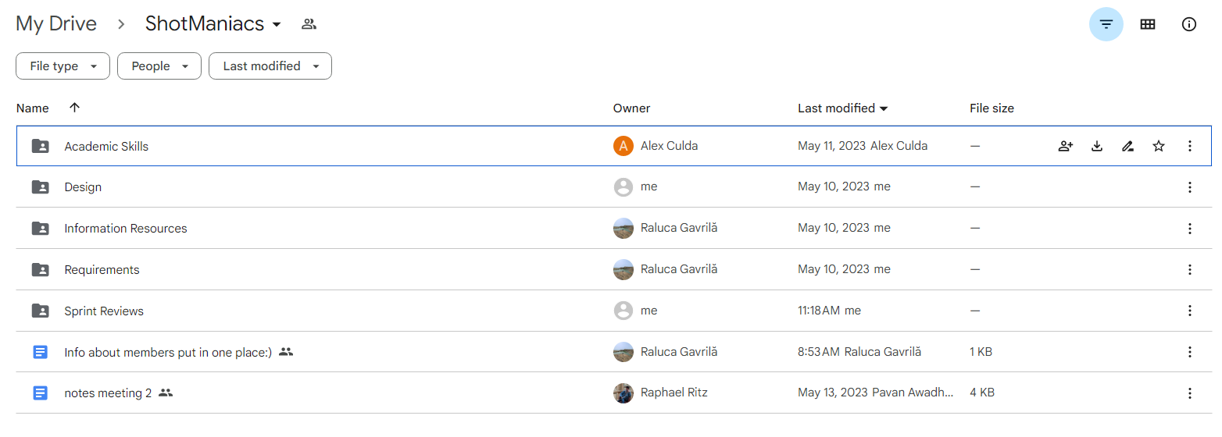
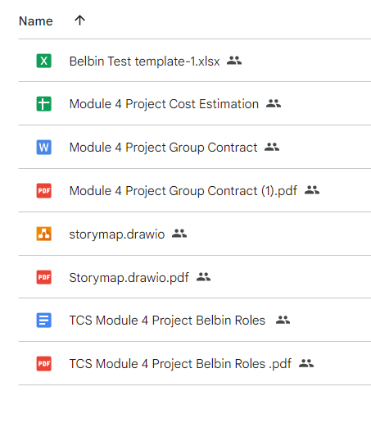
Drive

Slide 8
Planning.

Slide 9
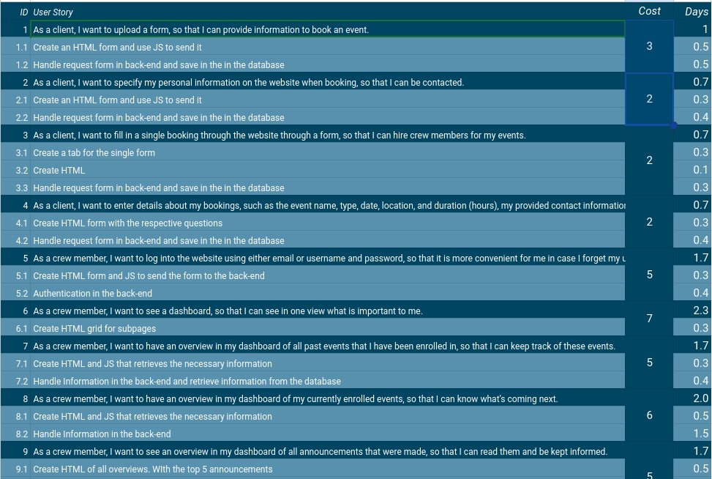
Cost estimation
User
9
Crew
29
23
Admin

Slide 10
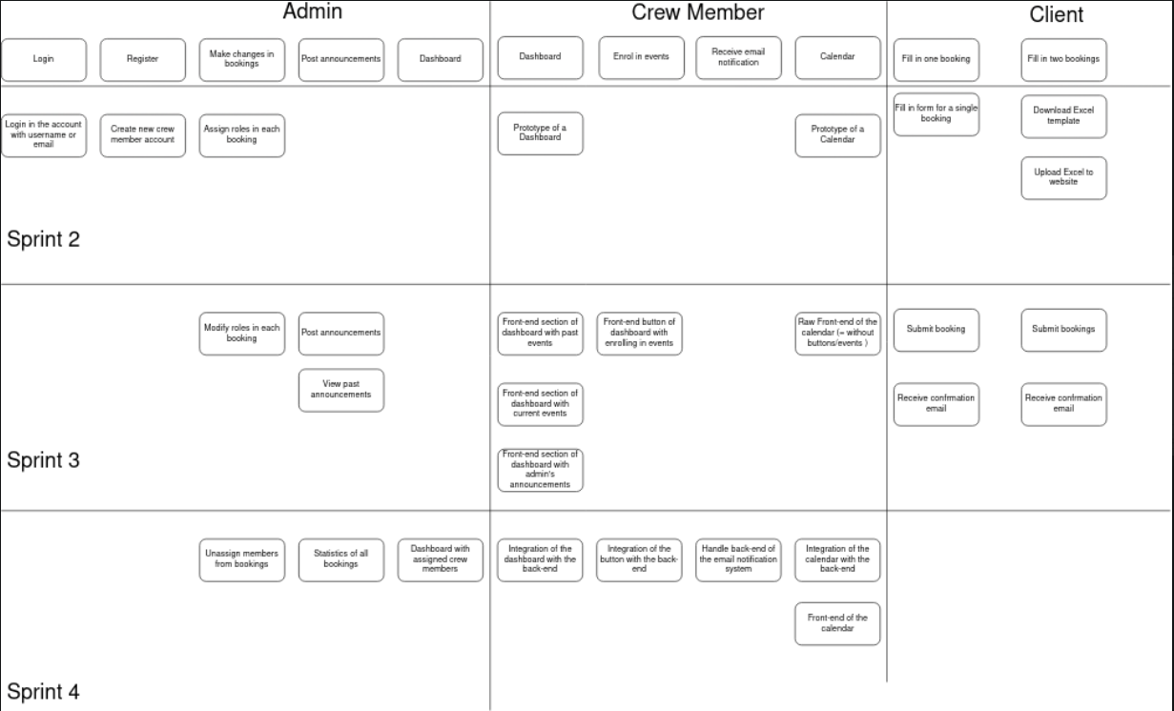
Story
Map

Slide 11
Design.

Slide 12
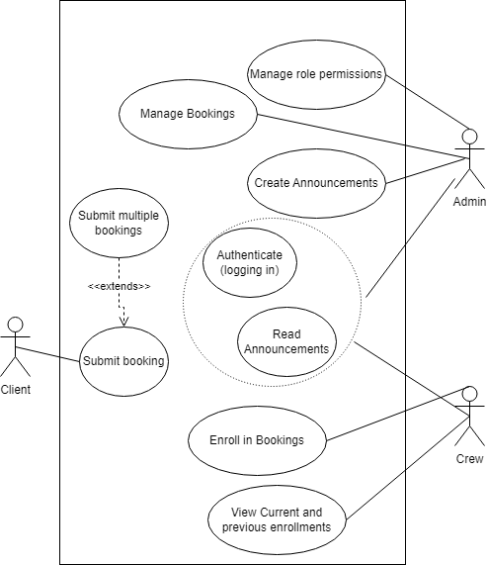
Use-case

Slide 13
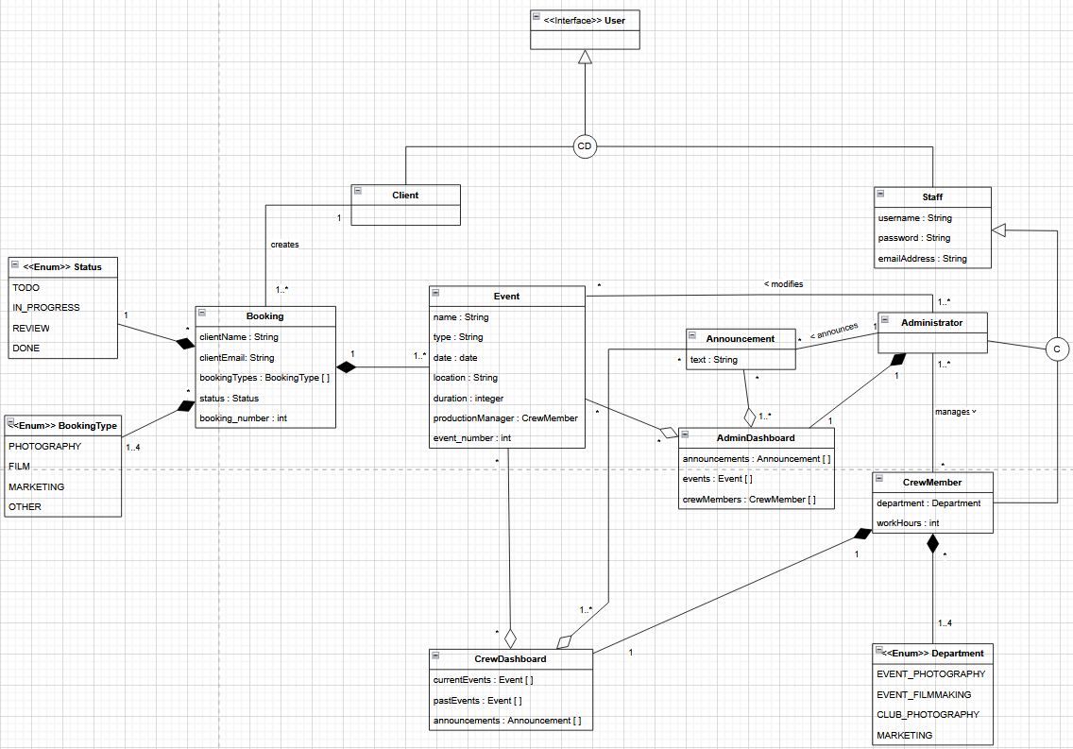
Class Diagram

Slide 14
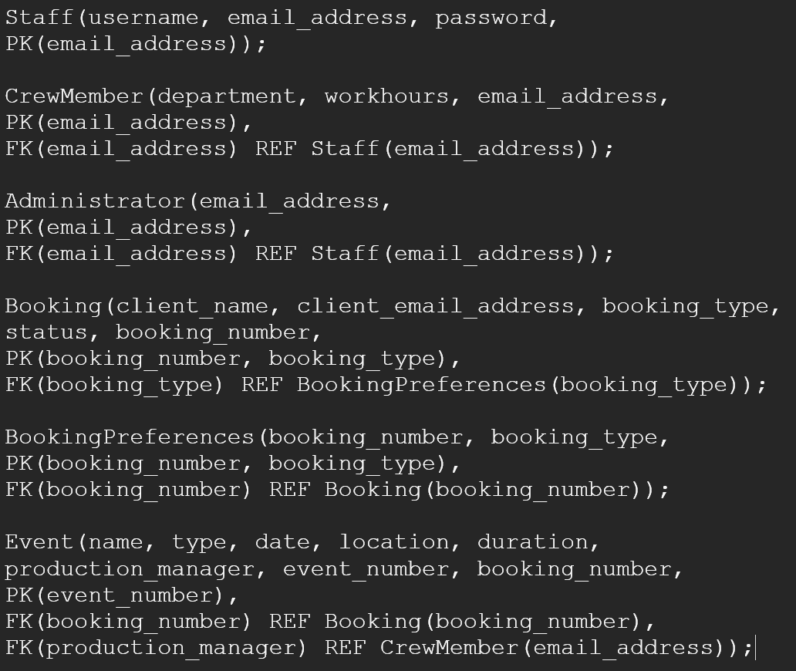
SQL-schema

Slide 15
Mock-up.

Slide 16




Tools &
Frameworks

Slide 17
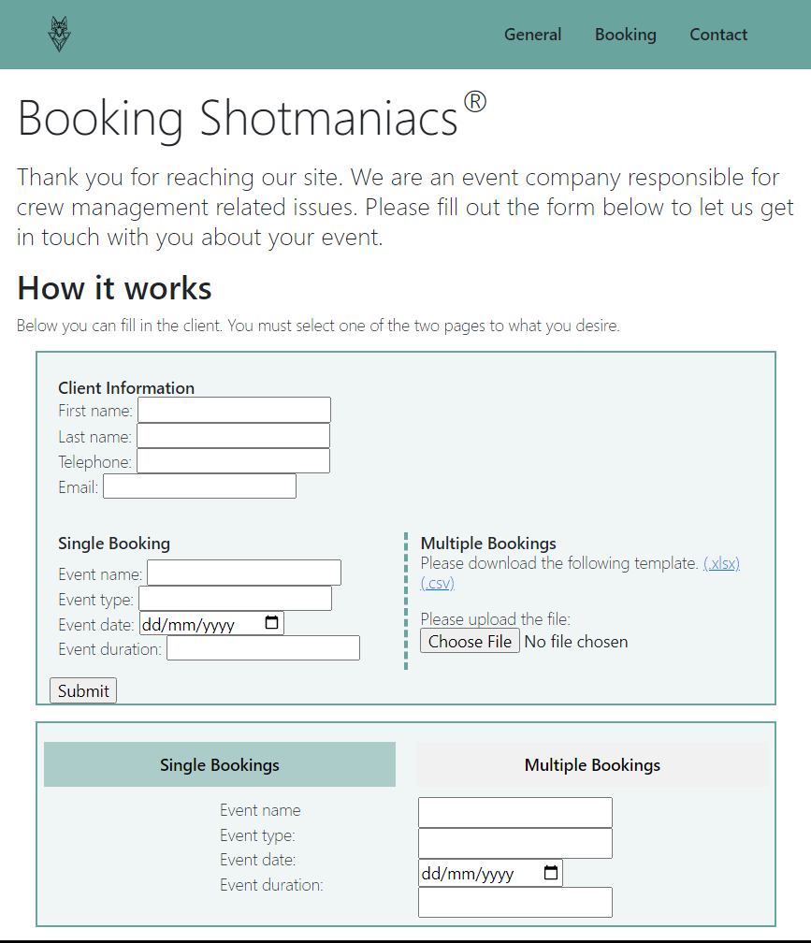
Client Page

Slide 18
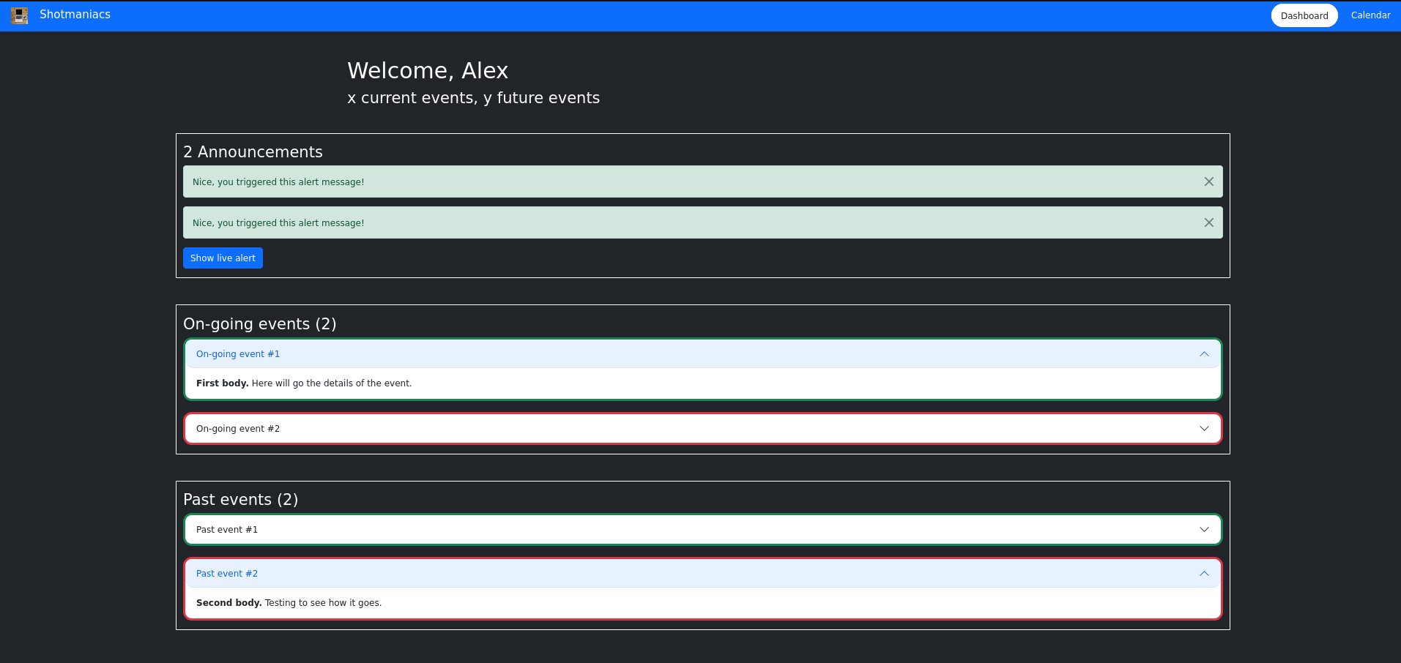
Client Page pt. 1

Slide 19
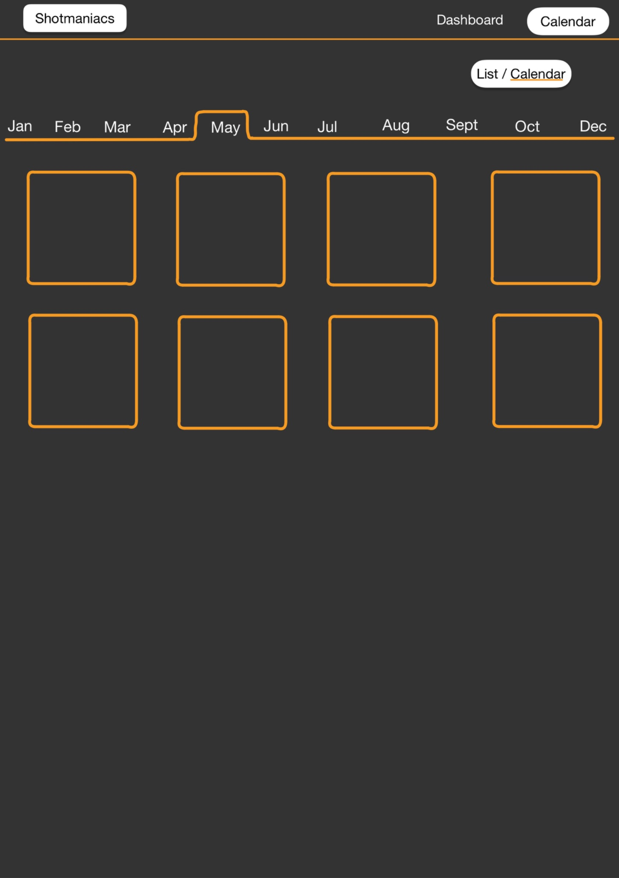
Crew Page
Calendar

Slide 20
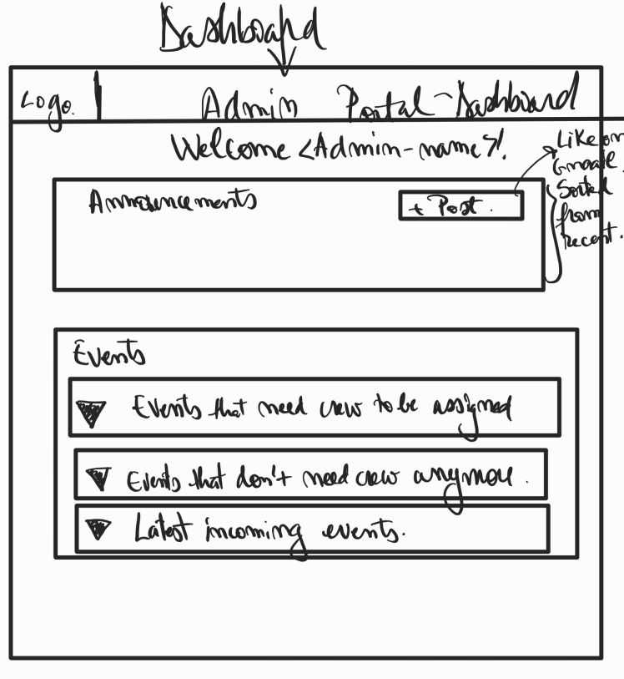
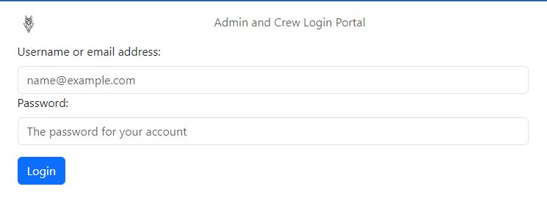
Admin Page

Slide 21
Thank you for listening.
Beau Jonkhout, Pavan Awadhpersad, Baris Yilmaz, Raphael Ritz, Alex Culda, Raluca Gavrila

Slide 22
Questions..?

